Slide 1

People’s perception of the Covid-19 vaccine through Twitter Sentiment analysis
INST 767 Big Data Analytics
Submitted By: Neviya Prakash

Slide 2

Introduction
The main purpose of this project is to measure the public response to the COVID-19 vaccine with sentiment analysis.
Though the vaccine has provided a new hope it has also resulted in several anti-vaccine movements
In order to analyze the public opinions and emotions related to the vaccine during the pandemic, I will be utilizing recent Twitter data.

Slide 3
Sentimental Analysis
Sentiment analysis is a natural language processing technique used to determine whether data is positive, negative or neutral.
Sentiment analysis is often performed on textual data to help businesses monitor product/brand sentiment in customer feedback and understand customer needs in real time.

Slide 4
Work Flow
Data Pre Processing
Filtering
Tokenization
Stop word Removal
Lemmatization
Data Collection using Twitter API
Exploratory Analysis
Sentimental analysis
Evaluation

Slide 5

Data Collection
1. Data Collection:
using Twitter’s stream API we have collected 20,000 tweets using the following search terms
”vaccination AND covidvaccine OR covid AND pro OR antivax OR antivaxxer
Since there was an issue with the tweet rate I have also used an external data set from Kaggle which uses the term Covidvaccine, this contains data from Dec 2020 to March 2021
After combining the datasets, I have checked for duplicates, the total data size is about 50k tweets
Sample data

Slide 6
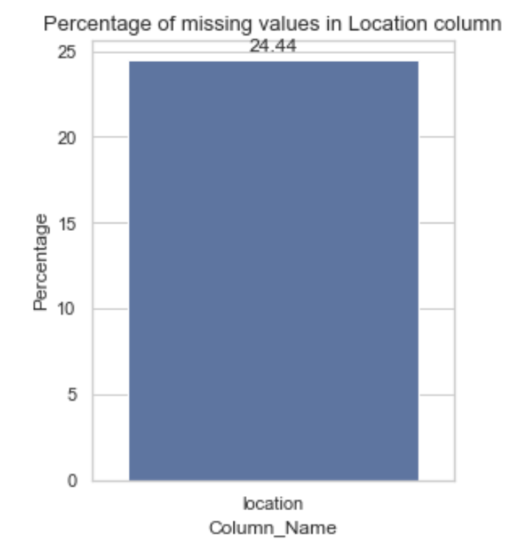
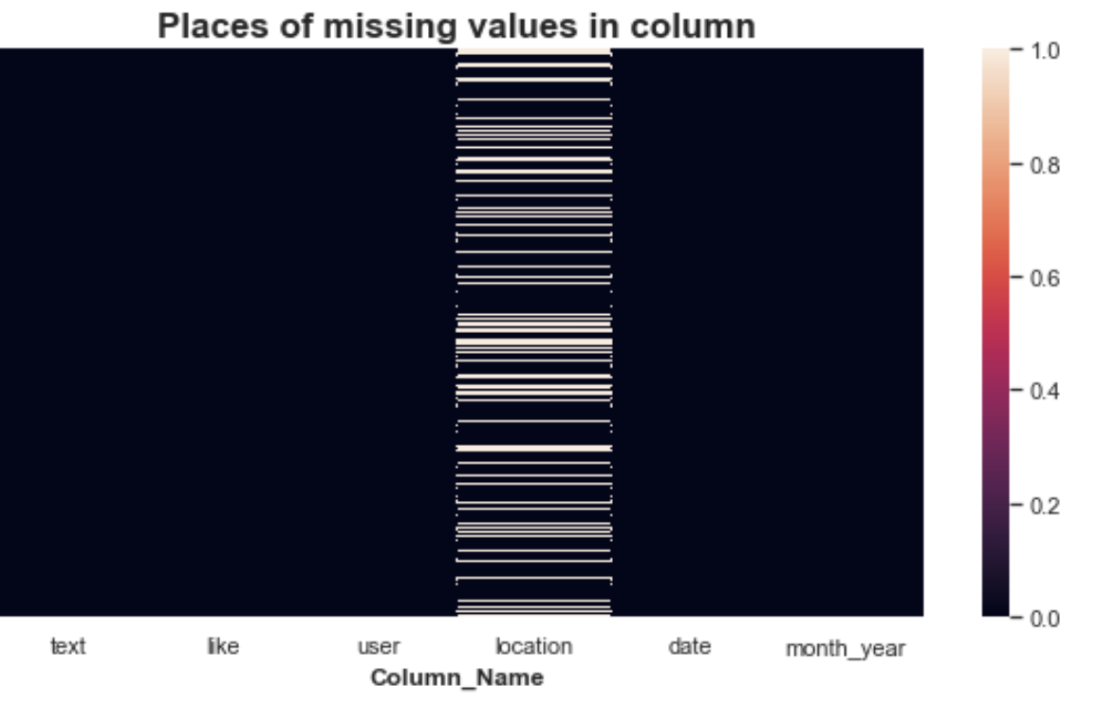
Exploratory Analysis
1. Check for missing values in the dataset
Location column contains 24.4% of missing values
Created a heatmap to view if any other missing values are present
Notes:
For the classification of tweets according to their security relevance, two classifiers have been explored:

Slide 7
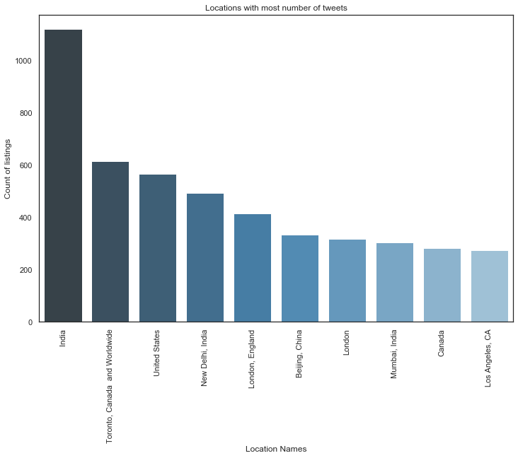
Exploratory Analysis
2. Check Location column
Have created the bar plot of the locations with most number of Tweets
Note that the city and country have created duplicates
Notes:
import geonamescache
from city_to_state import city_to_state_dict

Slide 8
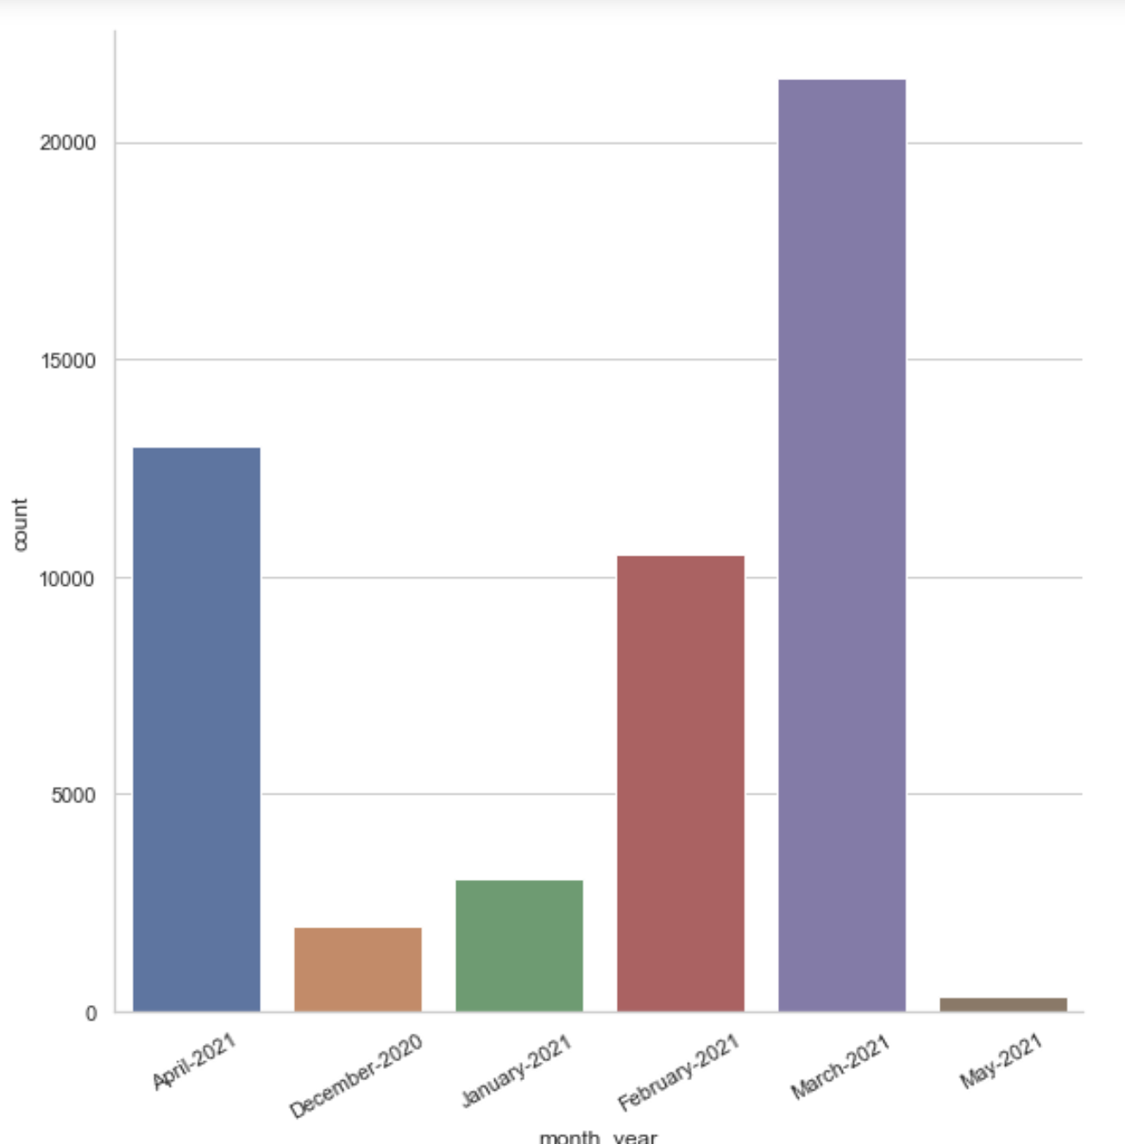
Exploratory Analysis
3. Check Number of tweets per month from Dec 2020 to April 2021
Number of tweets in March 2021 is highest
Notes:
For the classification of tweets according to their security relevance, two classifiers have been explored:

Slide 9
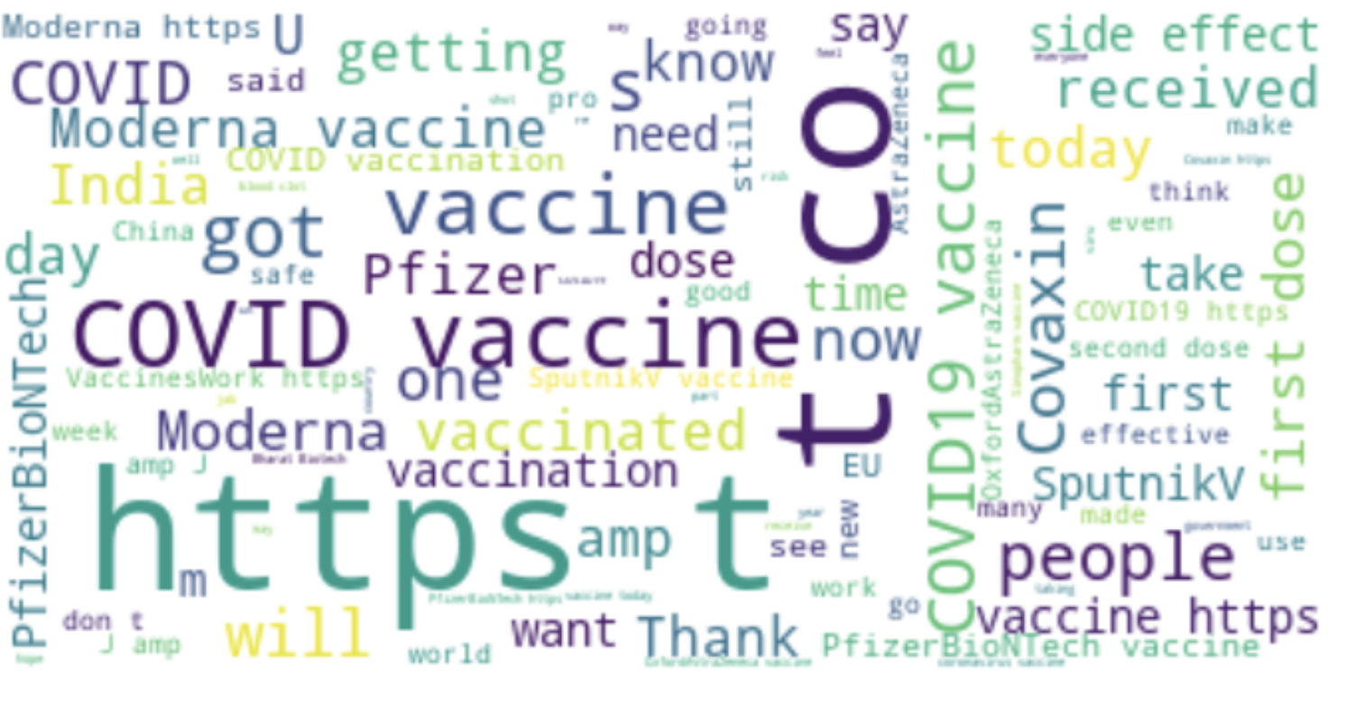
Exploratory Analysis
3. Check the tweet text
Have created a word cloud of the raw tweets
We see random words like https, t, etc
Notes:
For the classification of tweets according to their security relevance, two classifiers have been explored:

Slide 10
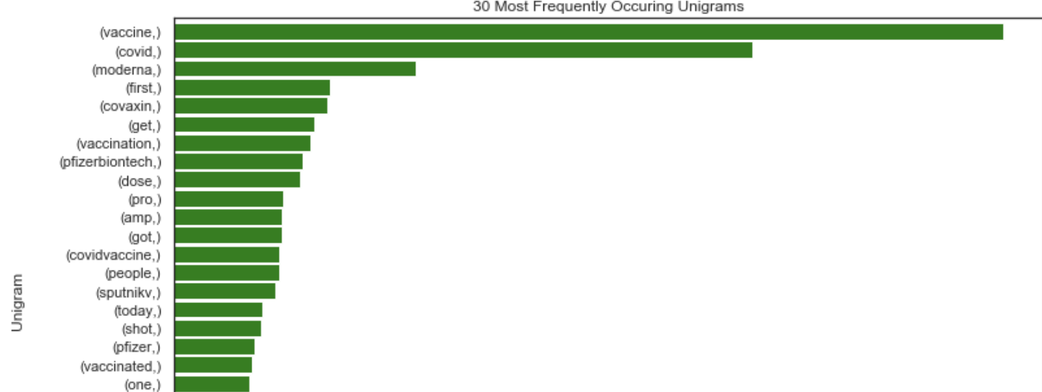
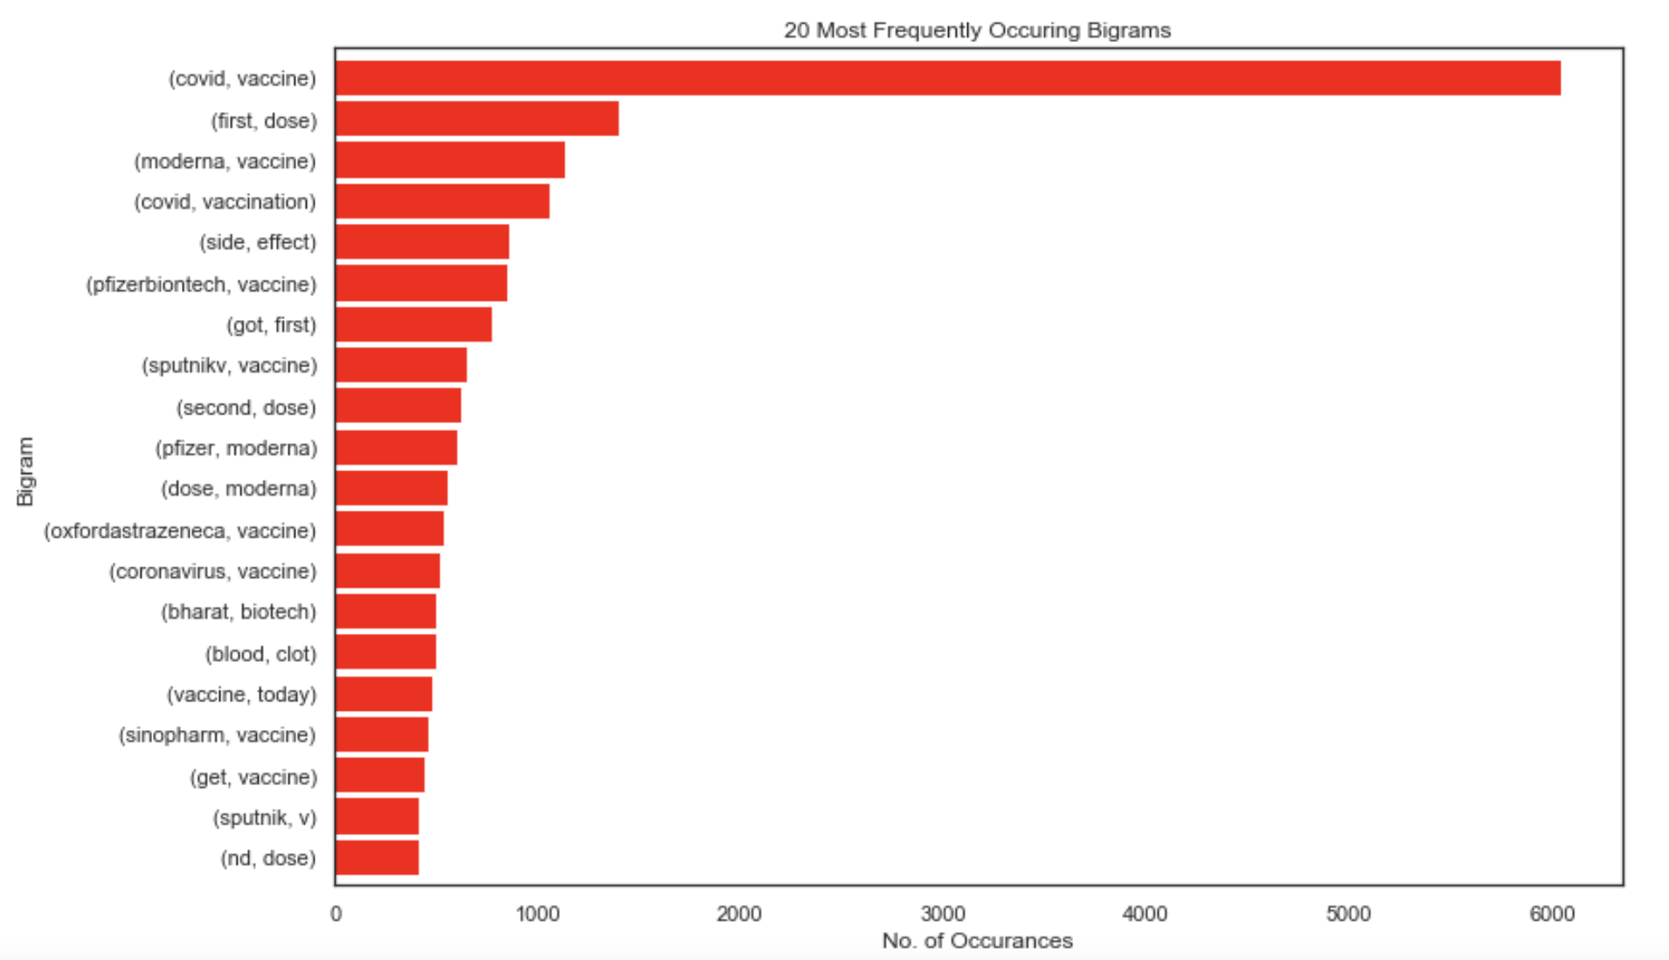
Text Processing
Remove punctuations, mentions hashtags, urls
Tokenization - Converting a sentence into list of words
Remove stopwords, Lemmatization- Transforming any form of a word to its root word
Plotted the Unigram, Bigram and trigram of frequently occurring words

Slide 11
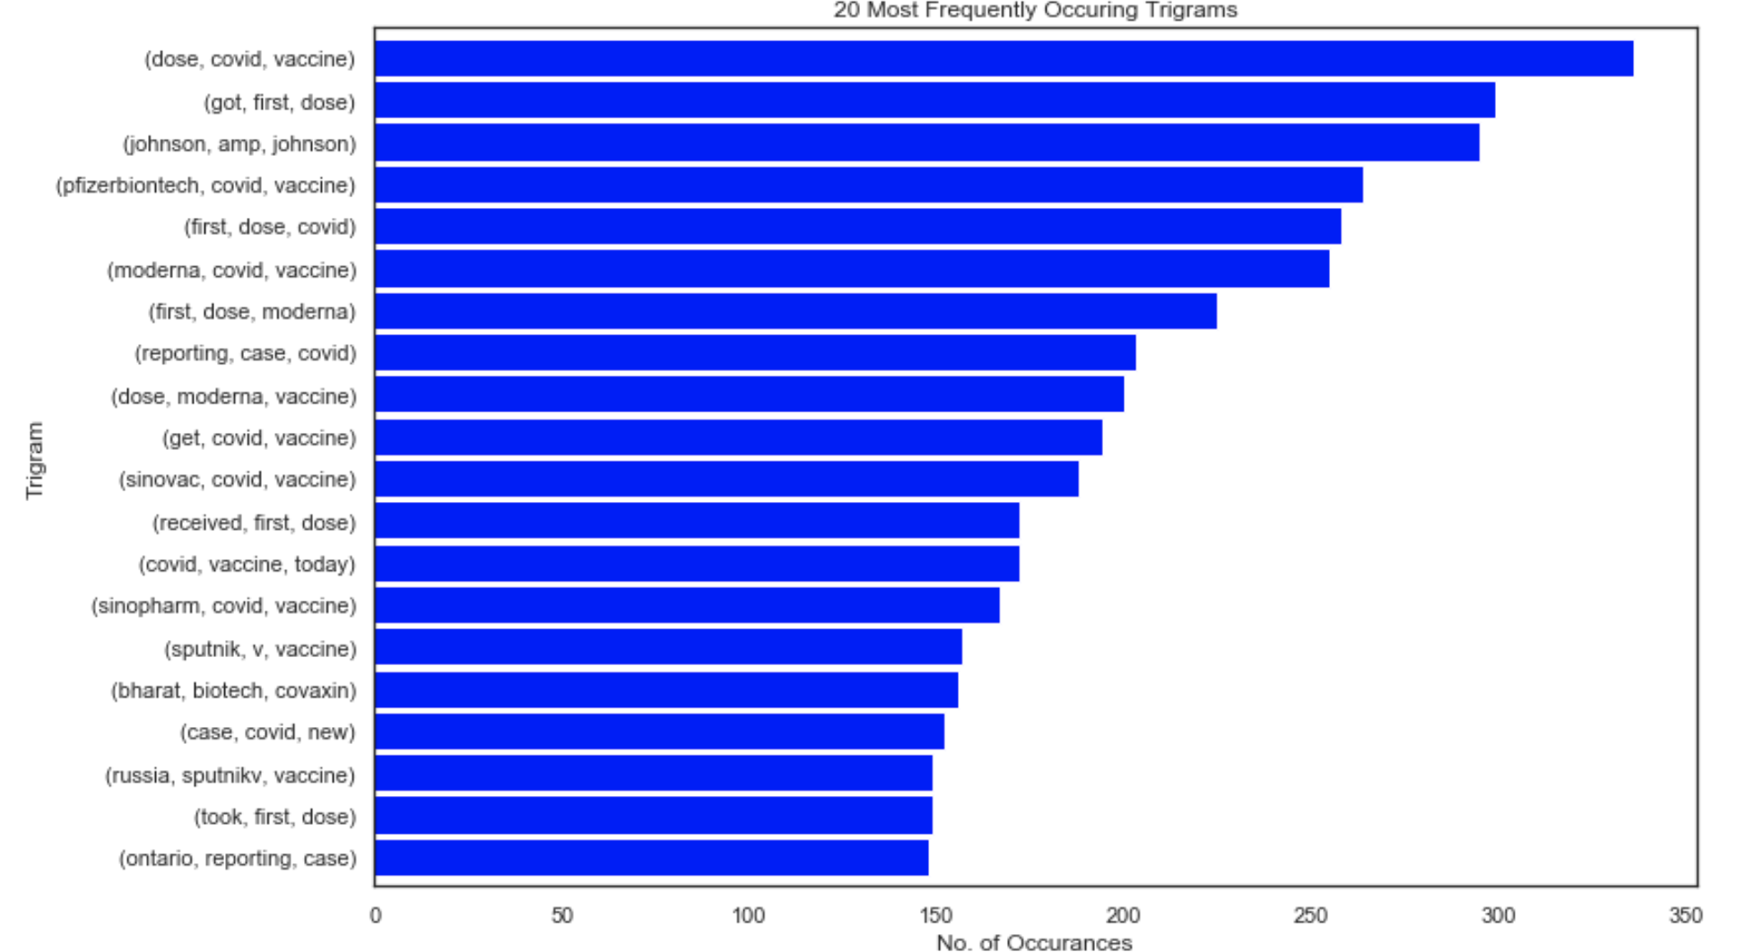
Text Processing
Trigrams

Slide 12
Sentimental Analysis using VADER
Import VADER((Valence Aware Dictionary and sEntiment Reasoner) model and using its methods, define separate functions to return compound, positive, negative and neutral scores.
It is available in the NLTK package and can be applied directly to unlabeled text data.
This method combines a lexicon approach with a rule-based approach to provide a high level of accuracy when scoring sentiment on social media.
The sentiment analyzer is run by passing each string to the polarity_scores method.
The result is a dictionary with four elements: neg, neu, pos, and compound.
These represent the negative, neutral and positive sentiment as measured by the analyser plus a combination of the scores to produce an overall sentiment value.
neg, neu, pos, are in the range 0 to 1, whereas the compound result is between -1 and +1
Negative value represents a negative sentiment value and positive value means a positive sentiment. A value around zero means that the sentiment expressed is neutral.
Notes:
VADER sentimental analysis relies on a dictionary that maps lexical features to emotion intensities known as sentiment scores. The sentiment score of a text can be obtained by summing up the intensity of each word in the text.

Slide 13
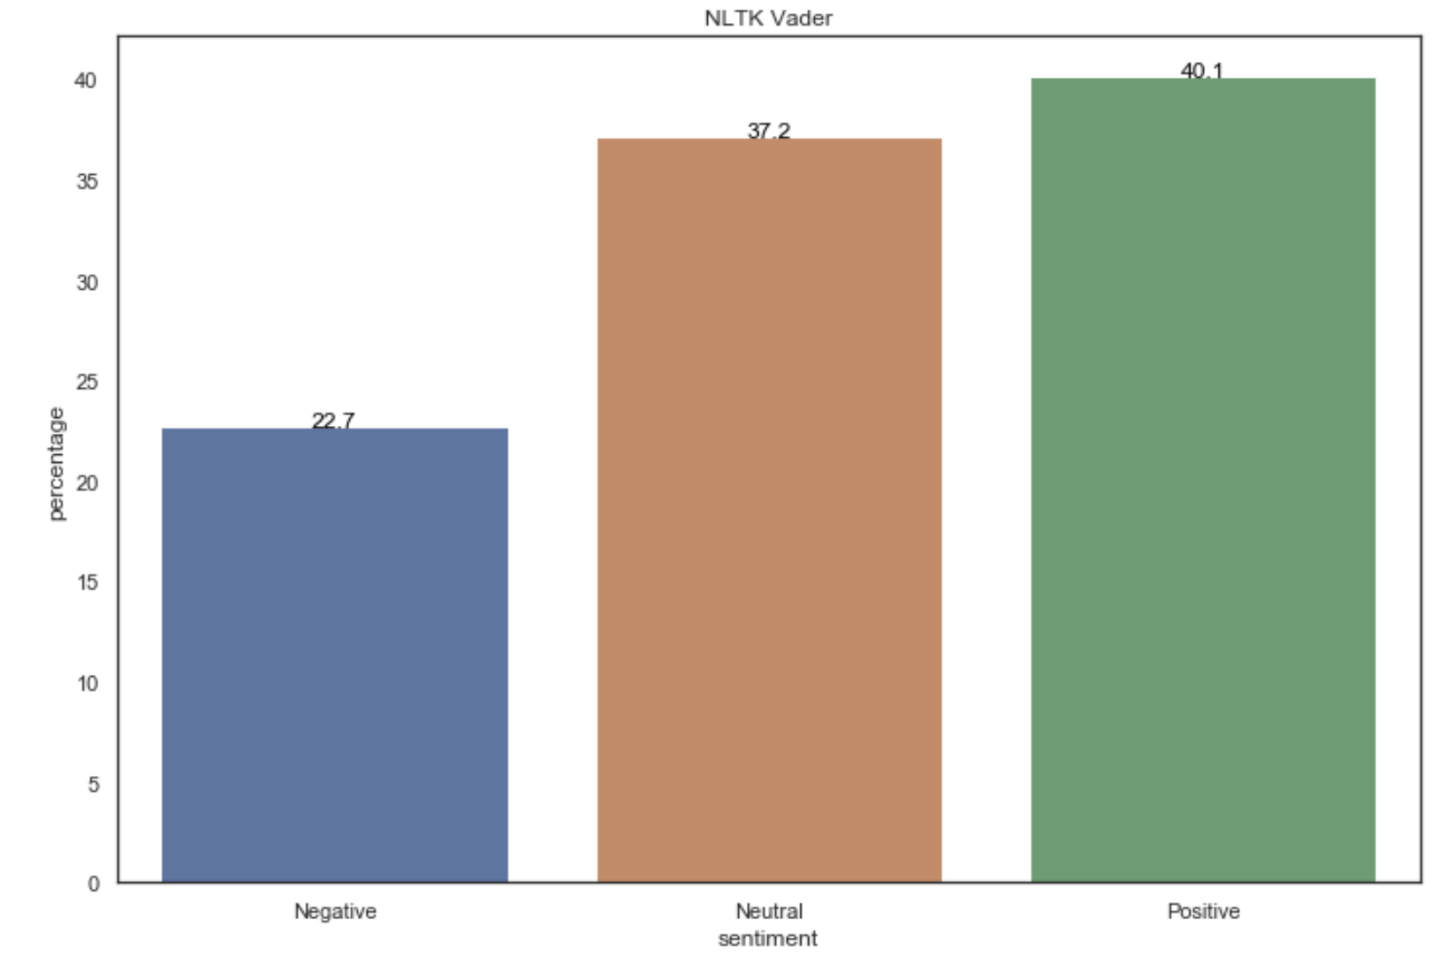
Sentimental Analysis using VADER
Using compound score on cleaned text
Percentage of positive tweets: 40.1%
Percentage of negative tweets: 22.7%
Percentage of neutral tweets: 37.2%
Using compound score on raw text
Percentage of positive tweets: 39.80%
Percentage of negative tweets: 21.96%
Percentage of neutral tweets: 37.44%
Notes:
VADER sentimental analysis relies on a dictionary that maps lexical features to emotion intensities known as sentiment scores. The sentiment score of a text can be obtained by summing up the intensity of each word in the text.
Notice that VADER:
It is case sensitive. The sentence This is great has a different score than the sentence This is GREAT.
Punctuation matters. The exclamation marks for example have a positive score
The emojis have also a score and actually very strong sentiments. Try the <3, :) , :p and :(
Words after @ and # have a neutral score.

Slide 14
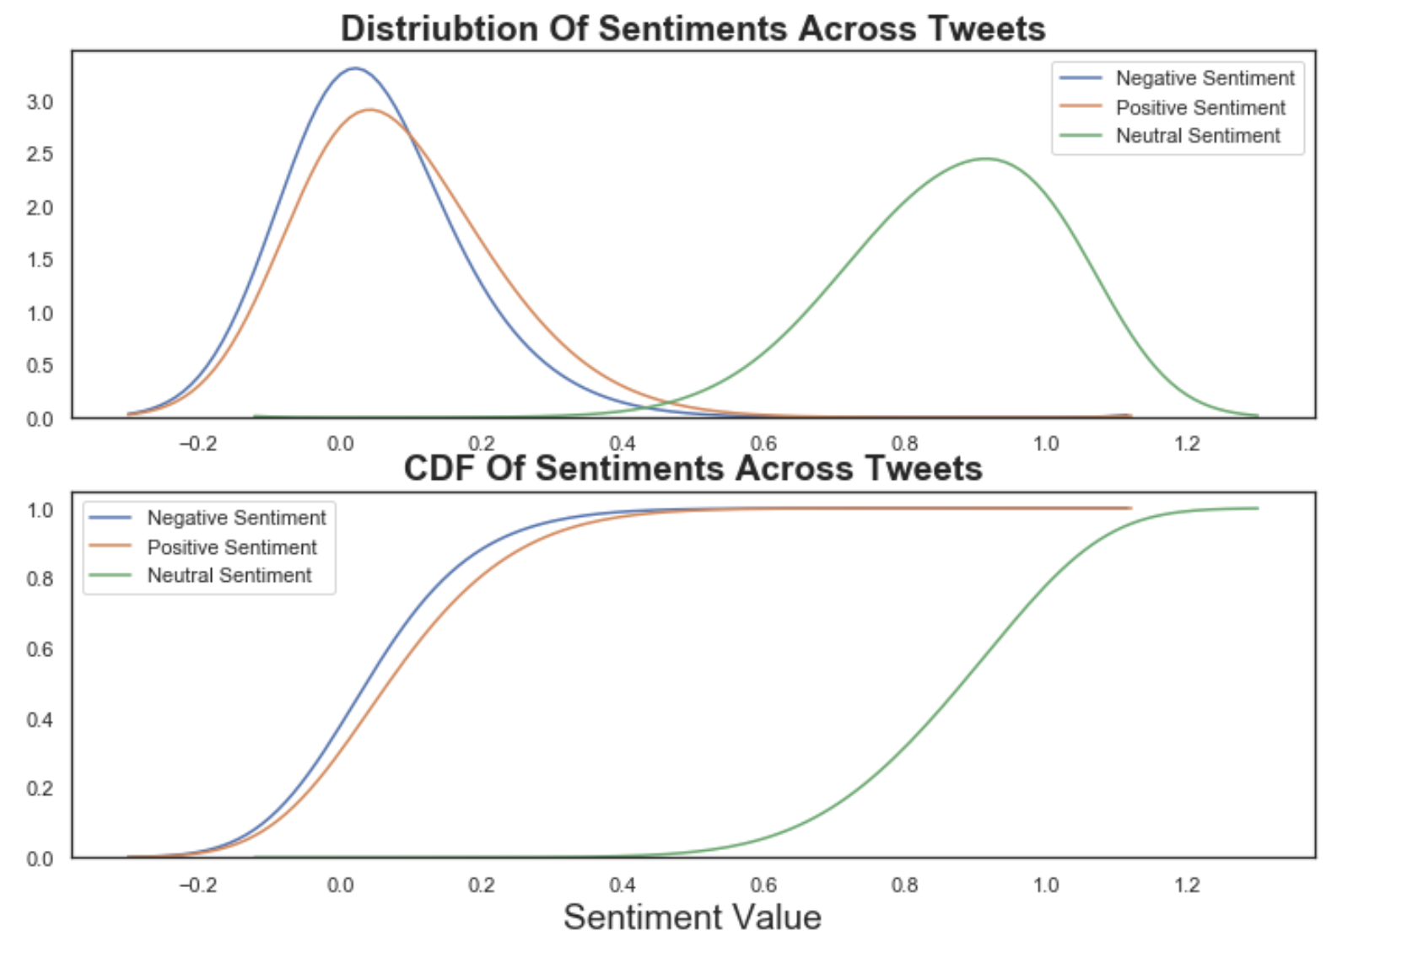
Sentimental Analysis using VADER
Distribution of Sentiments
A kernel density estimate (KDE) plot is a method for visualizing the distribution of observations in a dataset, analagous to a histogram.
KDE represents the data using a continuous probability density curve in one or more dimensions
The distributions of the sentiments indicates a normal distribution; the negative and positive sentiments are very similar
Notes:
VADER sentimental analysis relies on a dictionary that maps lexical features to emotion intensities known as sentiment scores. The sentiment score of a text can be obtained by summing up the intensity of each word in the text.
Notice that VADER:
It is case sensitive. The sentence This is great has a different score than the sentence This is GREAT.
Punctuation matters. The exclamation marks for example have a positive score
The emojis have also a score and actually very strong sentiments. Try the <3, :) , :p and :(
Words after @ and # have a neutral score.

Slide 15
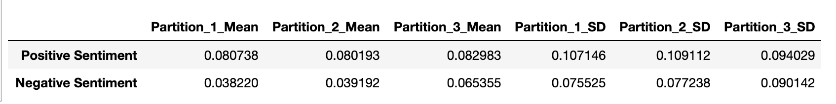
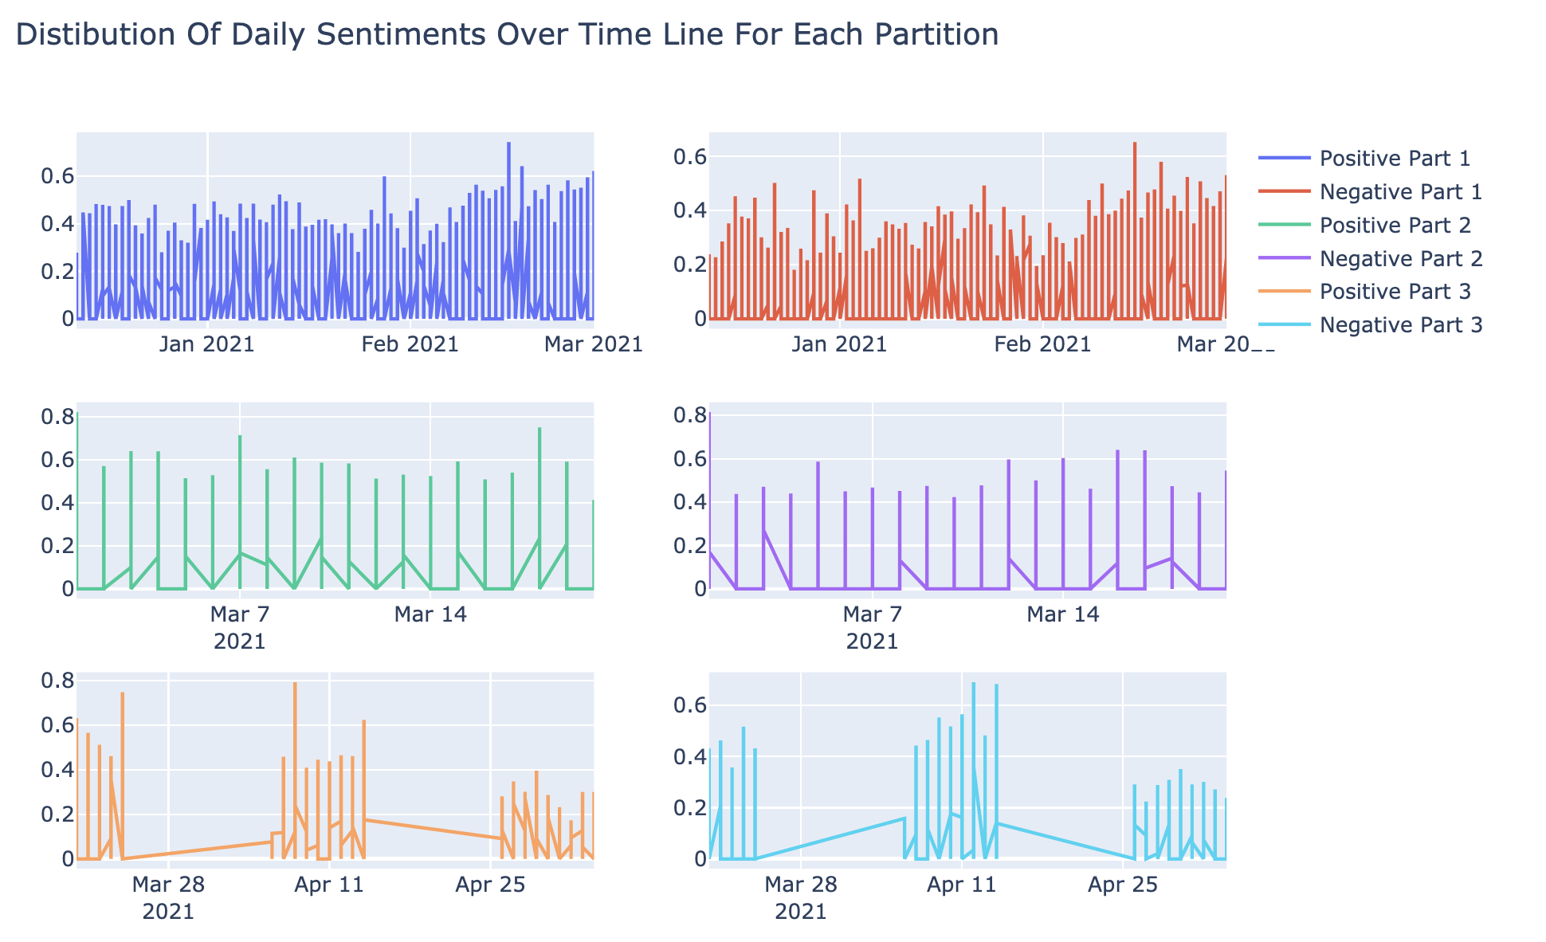
Sentimental Analysis using VADER
Daily Distribution of Sentiments over time
Divided into 3 partitions and calculated the mean and std deviations for each
Dec 2020- March 2021 higher density of positive tweets
March & April density of daily tweets seem to be less
Notes:
VADER sentimental analysis relies on a dictionary that maps lexical features to emotion intensities known as sentiment scores. The sentiment score of a text can be obtained by summing up the intensity of each word in the text.
Notice that VADER:
It is case sensitive. The sentence This is great has a different score than the sentence This is GREAT.
Punctuation matters. The exclamation marks for example have a positive score
The emojis have also a score and actually very strong sentiments. Try the <3, :) , :p and :(
Words after @ and # have a neutral score.

Slide 16
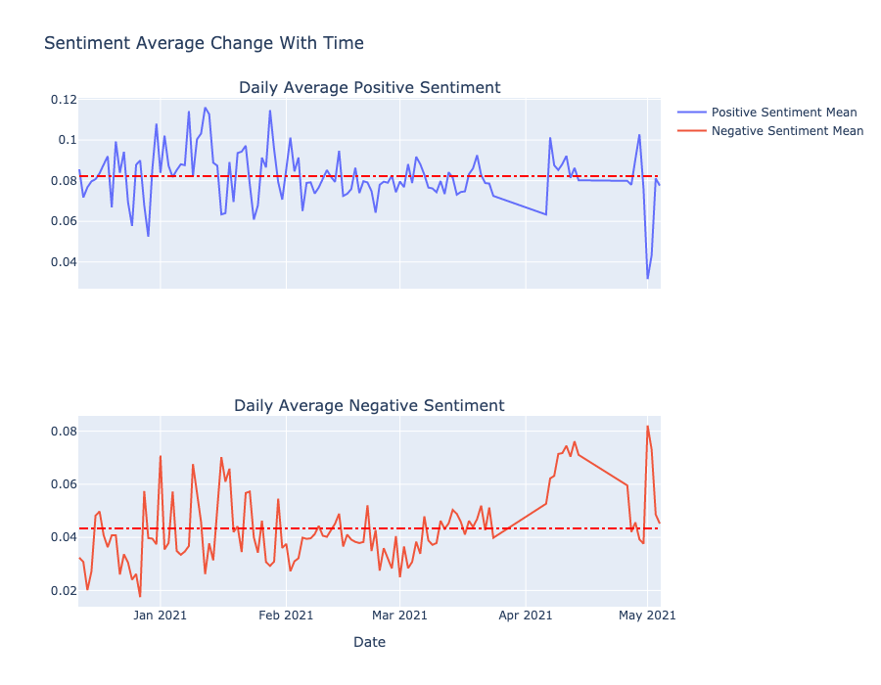
Sentimental Analysis using VADER
Distribution of Sentiments over time
Positive and Negative Sentiment mean from Dec 2020 to April 2021
From 18 December to December 29 there is a decline in the strength of the average negative sentiment, this could possibly be becasaue the U.S. Food and Drug Administration issued authorization for the use of Pfizer-BioNTech vaccine on Dec 14,& Moderna on Dec 18
Notes:
VADER sentimental analysis relies on a dictionary that maps lexical features to emotion intensities known as sentiment scores. The sentiment score of a text can be obtained by summing up the intensity of each word in the text.
Notice that VADER:
It is case sensitive. The sentence This is great has a different score than the sentence This is GREAT.
Punctuation matters. The exclamation marks for example have a positive score
The emojis have also a score and actually very strong sentiments. Try the <3, :) , :p and :(
Words after @ and # have a neutral score.

Slide 17
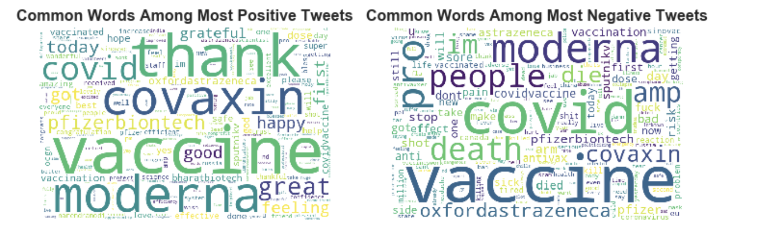
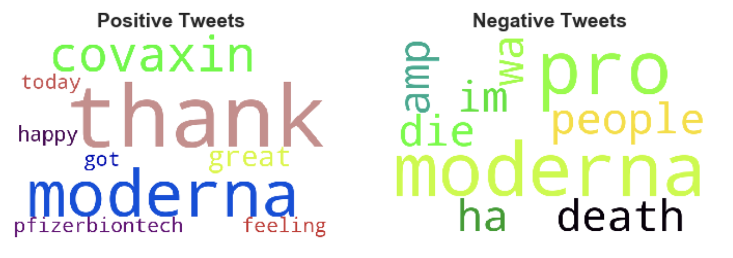
Sentimental Analysis using VADER
Word Cloud of Most common positive & Negative tweets
Word Cloud of top 10 positive & Negative tweets: After removing terms covid ,vaccine
Notes:
VADER sentimental analysis relies on a dictionary that maps lexical features to emotion intensities known as sentiment scores. The sentiment score of a text can be obtained by summing up the intensity of each word in the text.
Notice that VADER:
It is case sensitive. The sentence This is great has a different score than the sentence This is GREAT.
Punctuation matters. The exclamation marks for example have a positive score
The emojis have also a score and actually very strong sentiments. Try the <3, :) , :p and :(
Words after @ and # have a neutral score.

Slide 18
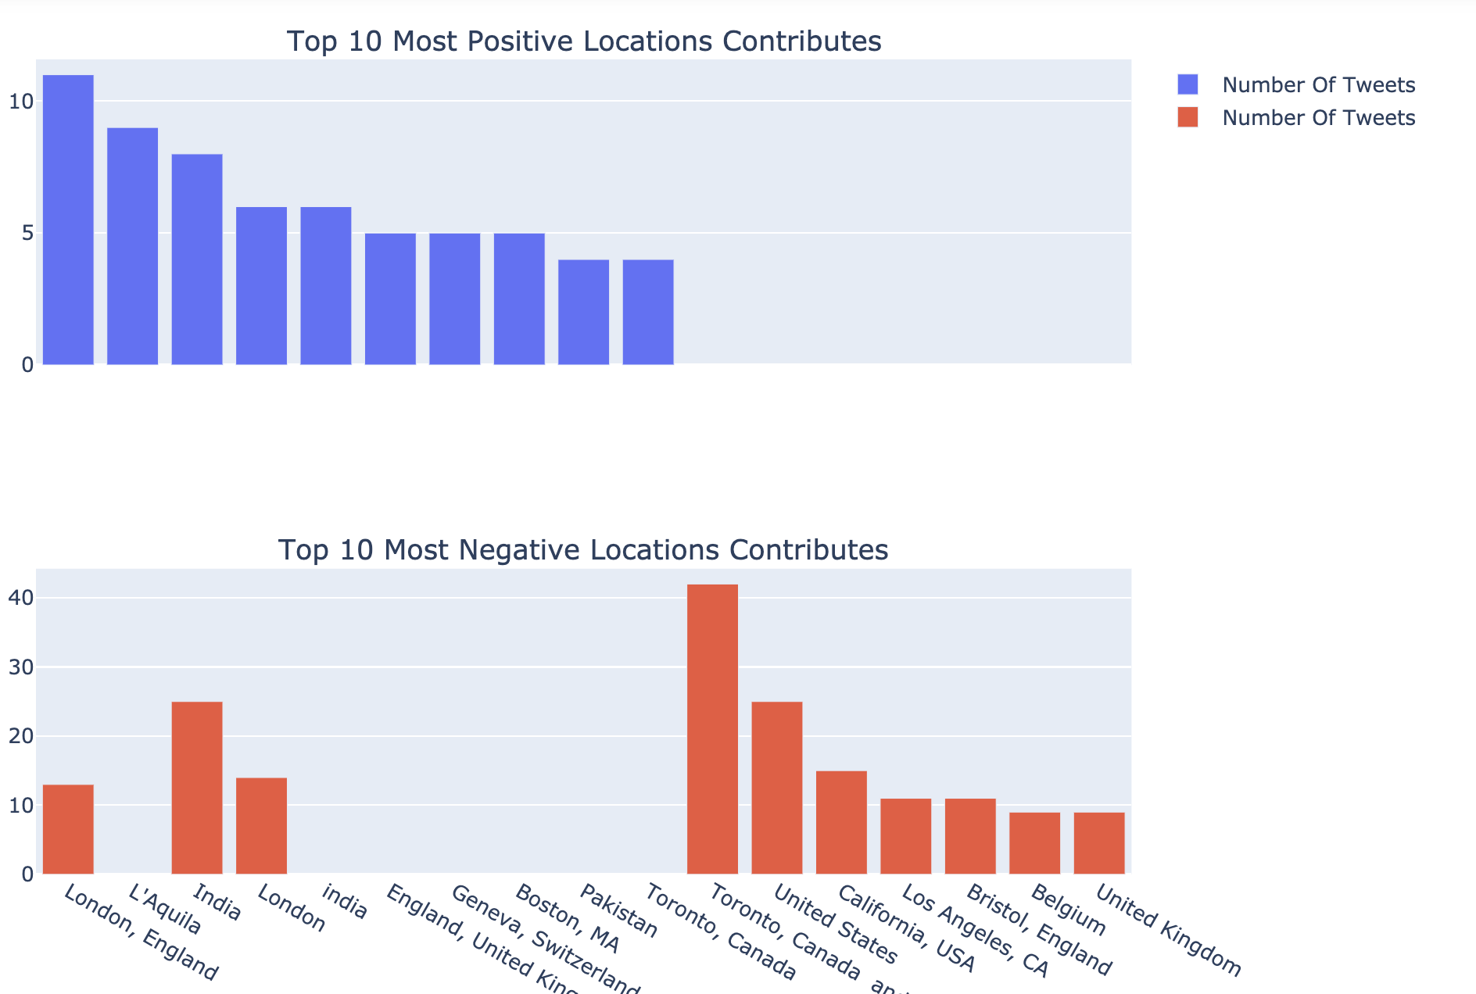
Location of Tweets based on sentiment
Have
London is seen to have high number of positive tweets
Toronto ,Canada seems to have high number of negative tweets.
Note: The location data has duplicates
Have tried using geonamescache , a Python library that provides functions to retrieve names of continents, countries as well as US states and counties as Python dictionaries.
However, it didn’t give the desired results
Notes:
VADER sentimental analysis relies on a dictionary that maps lexical features to emotion intensities known as sentiment scores. The sentiment score of a text can be obtained by summing up the intensity of each word in the text.
Notice that VADER:
It is case sensitive. The sentence This is great has a different score than the sentence This is GREAT.
Punctuation matters. The exclamation marks for example have a positive score
The emojis have also a score and actually very strong sentiments. Try the <3, :) , :p and :(
Words after @ and # have a neutral score.

Slide 19
Conclusion
Based on the sentiment analysis done, we learned that:
The dominant sentiment of covid vaccine-related tweets are positive.
The tweets tend to be more positive than negative on average.
The sentiment data is not stationary and there are also less in number of daily tweets in the month from March end to April first week to thus making it difficult to predict for people will feel about the vaccine with the current data.
There was a trend of decreasing negative sentiment strength from the 18th of December to the 27th, which was when the started vaccination.
There are recurring words both in the extremely negative and extremely positive tweets.
Some locations tend to be more negative/positive than others on average.
The sentiment strength of a tweet helps us to determine how the population is reacting to the vaccine; this can help the government to channel their advertisements towards more negative groups that usually refuse to believe in the integrity of the vaccine and observing the change over time

Slide 20
Future Work
Conduct the analysis on a larger amount of tweets
Compare text analysis results with other packages eg, Textblob
Improve the model to design a suitable cut off for positive and negative tweets, PyMC3 is a Python package for Bayesian statistical modeling and Probabilistic Machine Learning which focuses on advanced Markov chain Monte Carlo and variational fitting algorithms.

Slide 21
Thank You!
Any questions?

